Slide 1
Misleading Visualization
INFO 4602/5602

Slide 2
For each of the following charts, list what you think the misleading practice(s) employed is in the textbox to the right of the visualization.
You can discuss this with members of each group, but you should make your own slide deck and turn it in with your own answers at the end of class.

Slide 3
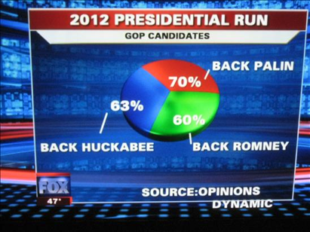
The number on the pie chart does not add to 100
The source is not clear
You cannot compare the size of the pie chart.

Slide 4
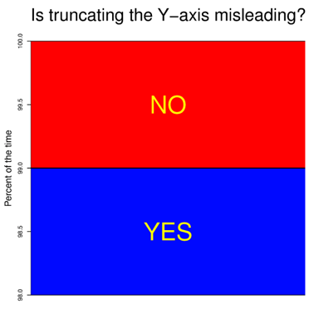
1. The title is on the left which is diffcult for people to tell what the chart is trying to tell
2. There is no x-axis for the chart.
3. There is no title for the chart, which make the chart has no meaning.

Slide 5
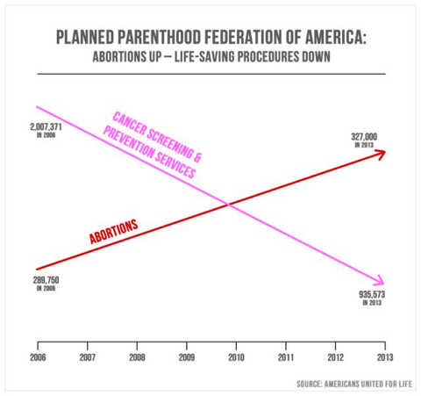
The slope of the line is not accurate.
There is no y-axis for the chart, which makes the chart less meaning.
The scale of the chart is not the same, which looks like there are two graph on the same chart.

Slide 6

1. The picture itself has no meaning(I get what the writer trying to say by looking the sentence at the bottom.
2. The color if the chart and the image is wired.
3. The data is not super correlated.

Slide 7
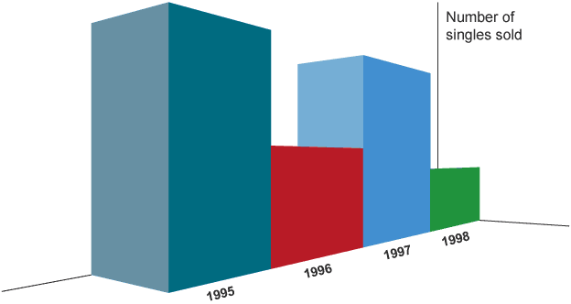
Th angle of the chart is wired, it is difficult to tell which one is higher.
There is no number on the axis of at the top of the chart.

Slide 8

1. There are too many colors in one area which is hard to read.
2. The title of the chart is not clear; it needs a clear topic.

